Slide 1


AIR QUALITY FORECASTING
Group-4
Mr. Karan Mangesh Gangwal
Mr. K. Niranjan raju
Miss. Varsha R Chintamani
Mr F Mohamed Hamdhan
Ms. Himangi
Ms. S SHARMILI
Ms. Mupparam Srividya
Mentor Name-Adhvaith
Date -16.03.2023

Slide 2
Business Problem:
To forecast Co2 levels for an organization so that the organization can follow government norms with respect to Co2 emission levels.

Slide 3
Project Architecture / Project Flow
EDA
Feature Engineering
Model Building
Model Evaluation
Model Deployment
Data Transformation

Slide 4
Exploratory Data Analysis (EDA) and
Feature Engineering

Slide 5
EDA
Shape of the data (215,2)
There are two column features i.e., Year and CO2 levels. Both are in FLOAT datatype
No Null values and duplicate values observed
No outliers detected
Converting year into date datatype in the format of year.

Slide 6
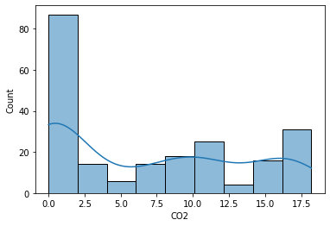
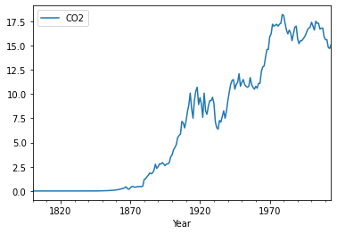
DATA DISTRIBUTION Density Plot
Skewness of Feature is 0.3602
Kurtosis of Feature is -1.4123

Slide 7
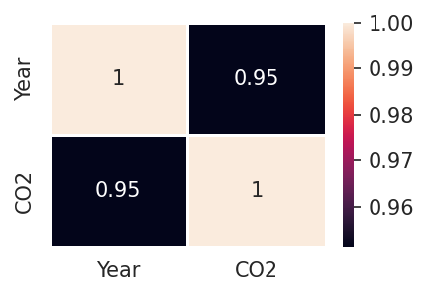
DATA DISTRIBUTION
Correlation Heatmap
The year and CO2 column are highly correlated
 | CO2
count | 215.000000
mean | 6.741970
std | 6.522437
min | 0.001750
25% | 0.041050
50% | 6.390000
75% | 11.500000
max | 18.200000

Slide 8
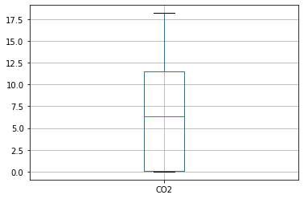
Outlier Detection
For testing outliers we use box plot method, IQR method and Z-scores method we get result that there is no outliers in our dataset
Using Shapiro-Wilk Normality test, the p-values are less than .05, we reject the null hypothesis.
We have sufficient evidence to say that the sample data does not come from a normal distribution.

Slide 9
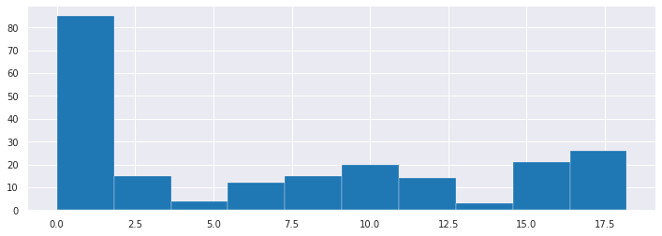
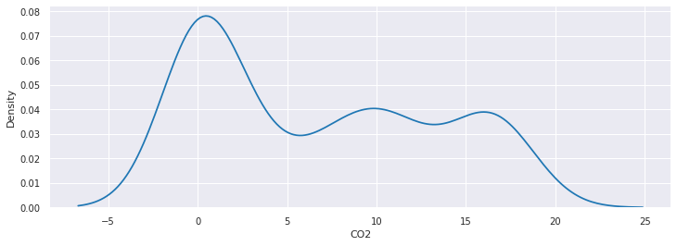
DATA TRANSFORMATIONS
Data transforms are intended to remove noise and improve the signal in time forecasting series
Univariate Analysis

Slide 10
Bivariate Analysis
Transforming techniques used:
logarithmic transformation
Reciprocal transformation
Square-root transformation
Cube root transformation
Exponential transformation
Standard Scaling transformation

Slide 11
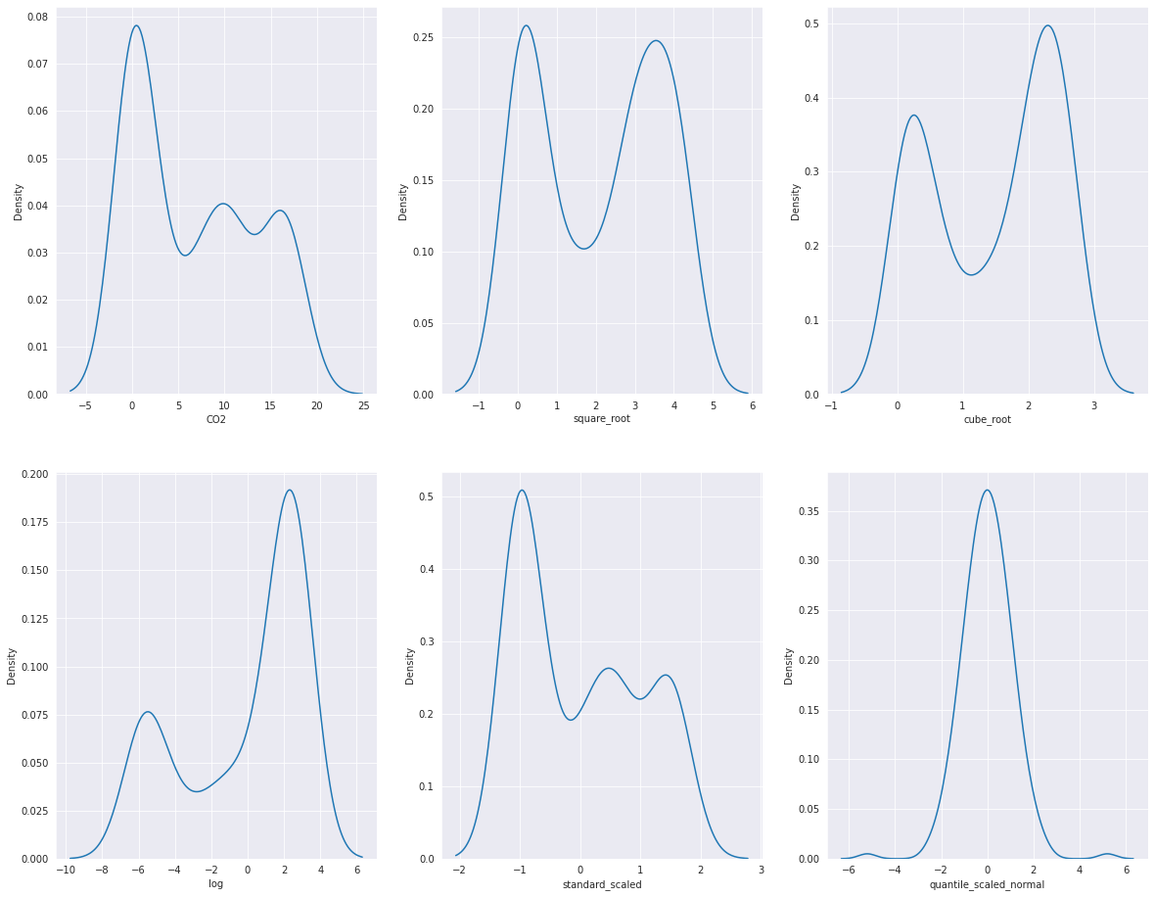

Slide 12
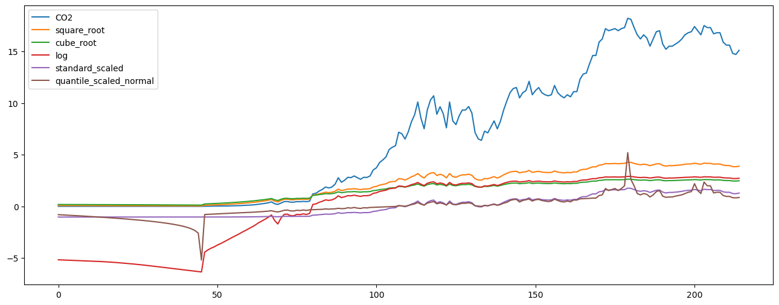
USING DIFFERENT TRANSFORMATIONS

Slide 13
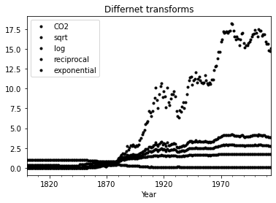
DIFFERENT K PLOT

Slide 14
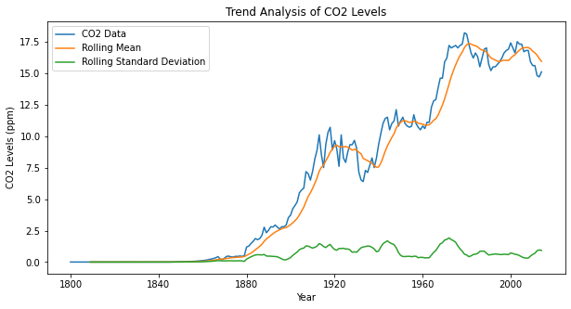
Trend Analysis
We calculate the rolling mean and standard deviation using a window size of 10 years.
We then plot the CO2 data, rolling mean, and standard deviation on a single graph using matplotlib.
By examining the plot, we can observe the overall direction of the CO2 data over time and identify any trends.
In this example, we can see that the CO2 data has an upward trend over time.

Slide 15
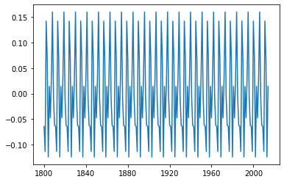
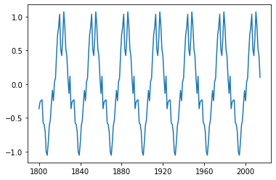
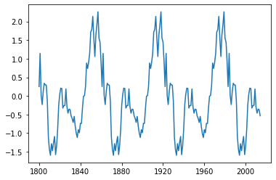
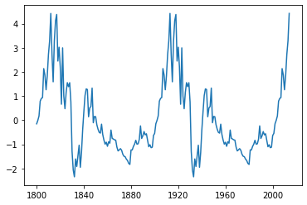
Seasonality Analysis
We have plotted different plots to Identify its seasonality And we find That data have one seasonality for every period
0 20 50 90

Slide 16
Stationary Analysis
We then use the adfuller function from the statsmodels library to perform the ADF test for stationarity. The test returns a test statistic and a p-value. If the p-value is below a certain threshold (e.g., 0.05), we can reject the null hypothesis of non-stationarity and conclude that the time series is stationary.
And by seeing the result we get that the data is stationary

Slide 17
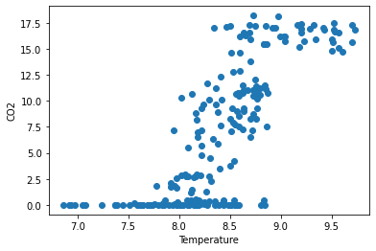
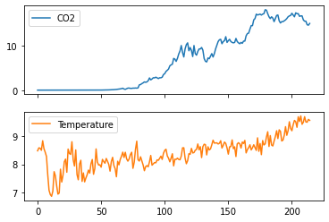
SCATTER PLOT
As we see in the graph that the relation between co2 and Temperature, it sees that the year is increasing and co2 is also increasing its showing positive corelation between the features

Slide 18
Model Building

Slide 19
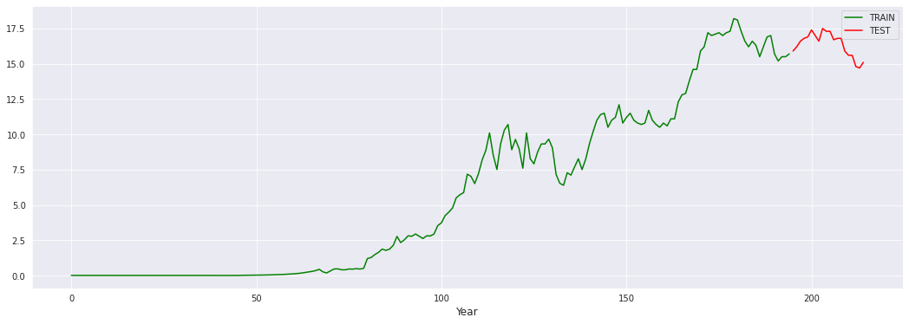
SPLITTING DATASET

Slide 20
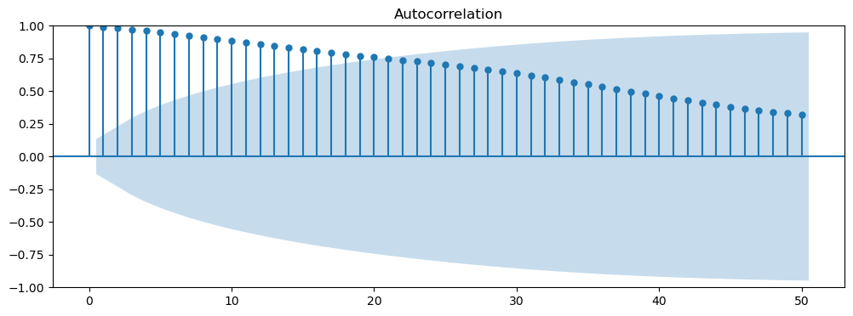
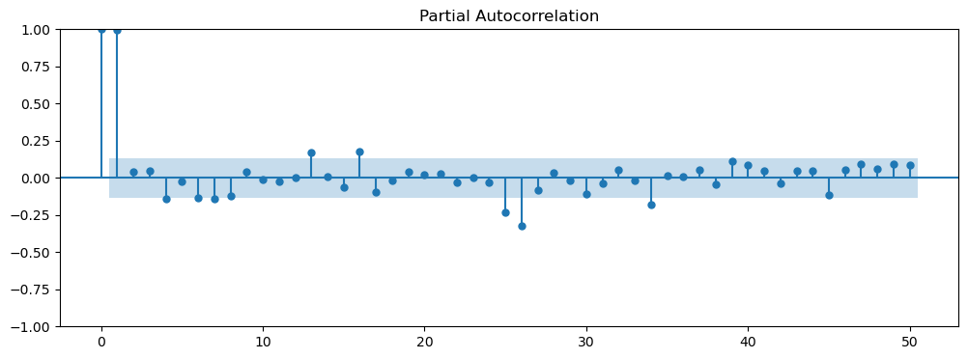
ARIMA MODEL
ACF PLOT
PACF PLOT
rmse_arima=1.1

Slide 21
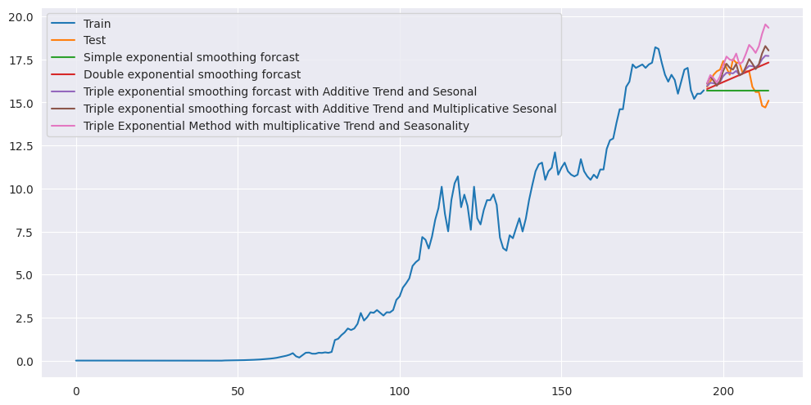
Visualizing Model Predictions

Slide 22
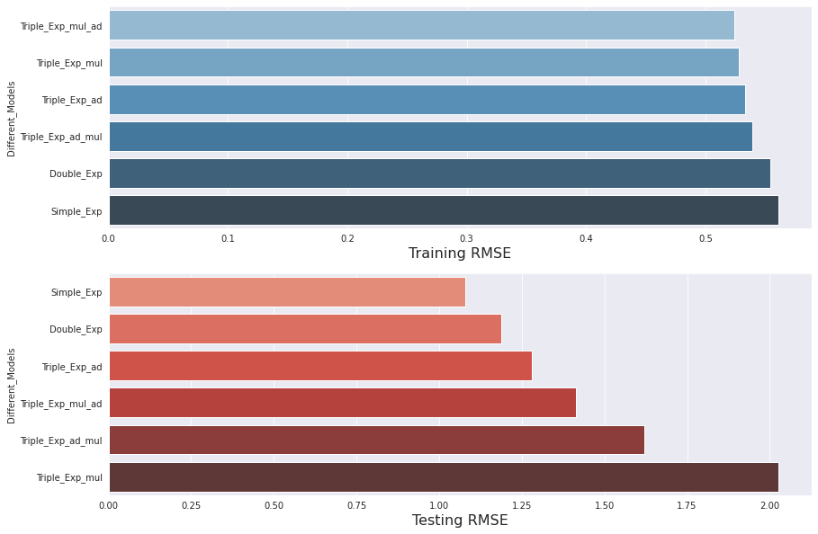
Model Evaluation

Slide 23
Model Predictions
YEAR | CO2
2000-01-01 | 16.906652
2001-01-01 | 16.901750
2002-01-01 | 16.905362
2003-01-01 | 16.902701
2004-01-01 | 16.904662
2005-01-01 | 16.903217
2006-01-01 | 16.904282
2007-01-01 | 16.903497
2008-01-01 | 16.904075
2009-01-01 | 16.903649
2010-01-01 | 16.903963
2011-01-01 | 16.903732
2012-01-01 | 16.903902
2013-01-01 | 16.903777
2014-01-01 | 16.903869

Slide 24
Model Deployment using Streamlit

Slide 25
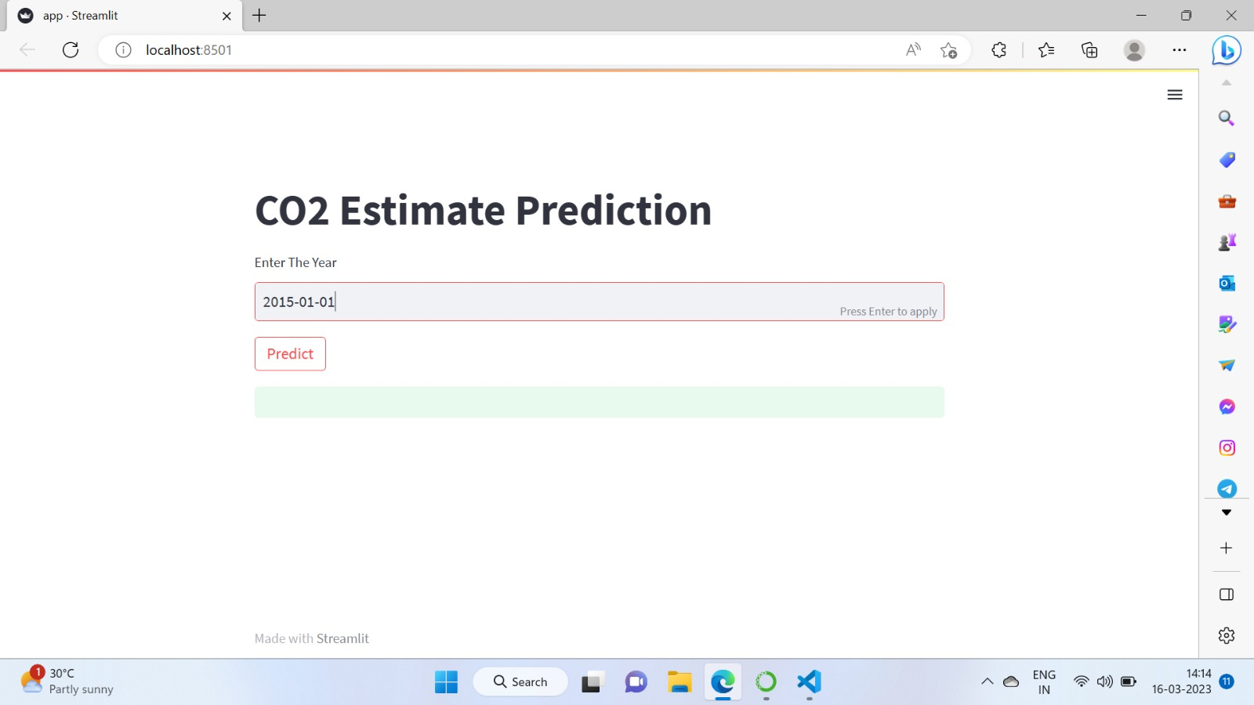

Slide 26
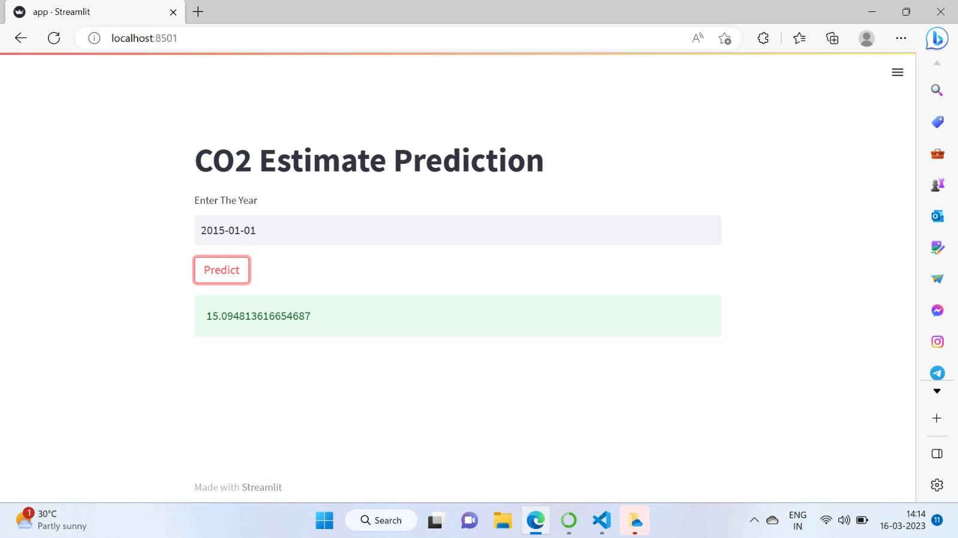

Slide 27
Thank you

